Slide 1
JetBrains Solution Hunters Hackathon
Geek Goddess 2019
FARMASSIST-A chatbot for farmers

Slide 2

Brief explanation of idea what makes it unique
There are many farmer chat-bots that gives the results of farmers queries but our response not only respond to the queries that are directly asked by the farmers but also recommends according to the current conditions of the farmer’s area .
The chatbot is interactive and can be talked to in generally which makes a person feel comfortable in all the aspects.

Slide 3
PROBLEM BEING SOLVED
According to a survey report-State of Indian Farmers,2018( conducted by CSDS(The Centre for Study of Developing Societies ),New Delhi -
76 percent of farmers would prefer to dome some other work than farming.
70 percent of farmers said their crops were destroyed due to unseasonal rains,drought,pest attack and floods.
64 percent of farmers are not aware of schemes like MSP and land acquisition law
THE FINDINGS CLEARLY SIGNIFY THE LACK OF TIMELY UPDATES ABOUT TEMPERATURE,HUMIDITY ,PRODUCTIVITY OF THEIR CROPS.
THIS ENCOURAGES US TO DEVELOP FARMASSIST-AN AI POWERED CHATBOT FOR FARMERS ….
For full CSDS report refer-http://www.lokniti.org/pdf/Farmers_Report_Final.pdf

Slide 4
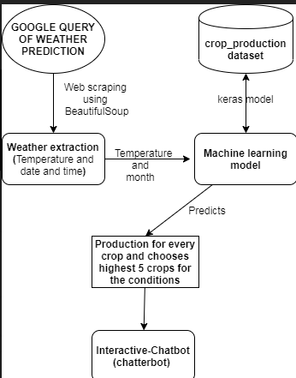
TECHNICAL ARCHITECTURE
First of all using web scraping for google query of weather prediction, the current conditions are extracted like temperature, humidity etc. to know which type of season it is like summer, winter, kharif, rabi etc.
Details like state, district, temperature, season are used to predict production of all types of crops and 5 highest production yielding crops are selected.
The interactive chatbot is made using chatterbot and the above results are recommended to the farmer for his better production.

Slide 5
TECHNOLOGY/TOOL STACK
BEAUTIFUL SOUP -Python library for web scraping
Detailed documentation-(https://www.crummy.com/software/BeautifulSoup/bs4/doc/)
KERAS -Python deep learning library.
Detailed documentation-(https://keras.io/)
CHATTERBOT-Python library for training the chatbot
Detailed documentation-(https://chatterbot.readthedocs.io/en/stable/)
JetBrains PyCHarm for training and testing model

Slide 6
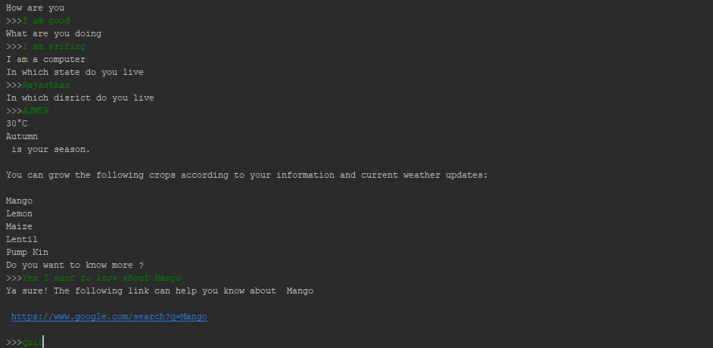
SCREENSHOTS:

Slide 7
Business problem you are solving
The problem is basically focused on farmers who generally used to sow same plants and when change in season patterns come, they generally face a high loss.
Our solution is focused to make them recommendations of high production crops so that they could have proper knowledge of crops they should sow according to their weather conditions.
Apart from business perspective it is also important to keep the food producing hands in our primary concern.

Slide 8
Impact of usage
Increased production of crops by making right choices.
Reduced loss of farmers and their crops.
An assistant to farmers that can at time also act as a buddy for them giving advices and results of what is asked.

Slide 9
POSSIBLE IMPROVEMENTS
The bot can be trained to provide real time information for latest government schemes and incentives for farmers by scraping information from web portals like https://agriculture.gov.in,krishijagran.com etc.
Online upload of photos for diseased crops to recognize type of pests through image recognition and suggest possible remedies for timely treatment of crops
Connecting banks and co-operatives to farmers through location based recommendations for farmers to help them get timely credits for their sowing season.

Slide 10
CHALLENGES FACED
Collecting appropriate data for training the model for predicting crop productivity was a challenge as we required data that predicted the suitable crops depending upon farmer’s location, temperature, humidity, agricultural season etc. We finally used a publicly available dataset(https://data.world/agriculture/crop-production)
Interactive Chatbot was difficult to train as it was getting too much noise while training through itself.

Slide 11


